Slide 1
GRIDS Kaggle Project: Time Series

Slide 2
Today’s Schedule (4/4)
1. Introduction
Who am I?
Who are you?
2. Our Goal
Project Goal
Project Timeline
3. Kaggle Project
What is Kaggle?
Kaggle Project Introduction
Setting up Project and Team
4. Data Understanding
Data Understanding and Problem Formation

Slide 3
1. Introduction
Who am I?
Who are you?
2. Our Goal
Project Goal
Project Timeline
3. Kaggle Project
What is Kaggle?
Kaggle Project Introduction
Setting up Project and Team
4. Data Understanding
Data Understanding and Problem Formation

Slide 4
Who am I?
1. Introduction
Name: Yuko Ohmori
Hometown (City, Country): Kobe, Japan
Major: MS in Applied Data Science
Hobby: Soccer and Bouldering
Interesting Fact: I like to learn new languages. Now learning Korean!

Slide 5
Who am I?
1. Introduction
Name: Ravneet Kaur
Hometown (City, Country):
Major:
Hobby:
Interesting Fact:

Slide 6
Who am I?
1. Introduction
Name:
Hometown (City, Country):
Major:
Hobby:
Interesting Fact:

Slide 7
1. Introduction
Who am I?
Who are you?
2. Our Goal
Project Goal
Project Timeline
3. Kaggle Project
What is Kaggle?
Kaggle Project Introduction
Setting up Project and Team
4. Data Understanding
Data Understanding and Problem Formation

Slide 8
Our Goals
2. Our Goal
Goal 1: Understand the overall flow of a Data Science Project by starting and finishing a DS project
Goal 2: Contribute to the project by asking questions and doing some research at home.
We can all learn from each other!

Slide 9
Project Timeline
Week 1
Introduction, our Goal
Kaggle Project Introduction
Data Understanding and Problem Formation
Week 2
Exploratory Data Analysis (EDA)
Preprocessing
Missing Values, Outliers
Normalization
Week 3
Feature Engineering
Feature Selection
Week 4
LSTM/GRU Model
Training Model
Predictions
Week 5
Improvements
Retrain Model
Predictions

Slide 10
1. Introduction
Who am I?
Who are you?
2. Our Goal
Project Goal
Project Timeline
3. Kaggle Project
What is Kaggle?
Kaggle Project Introduction
Setting up Project and Team
4. Data Understanding
Data Understanding and Problem Formation

Slide 11

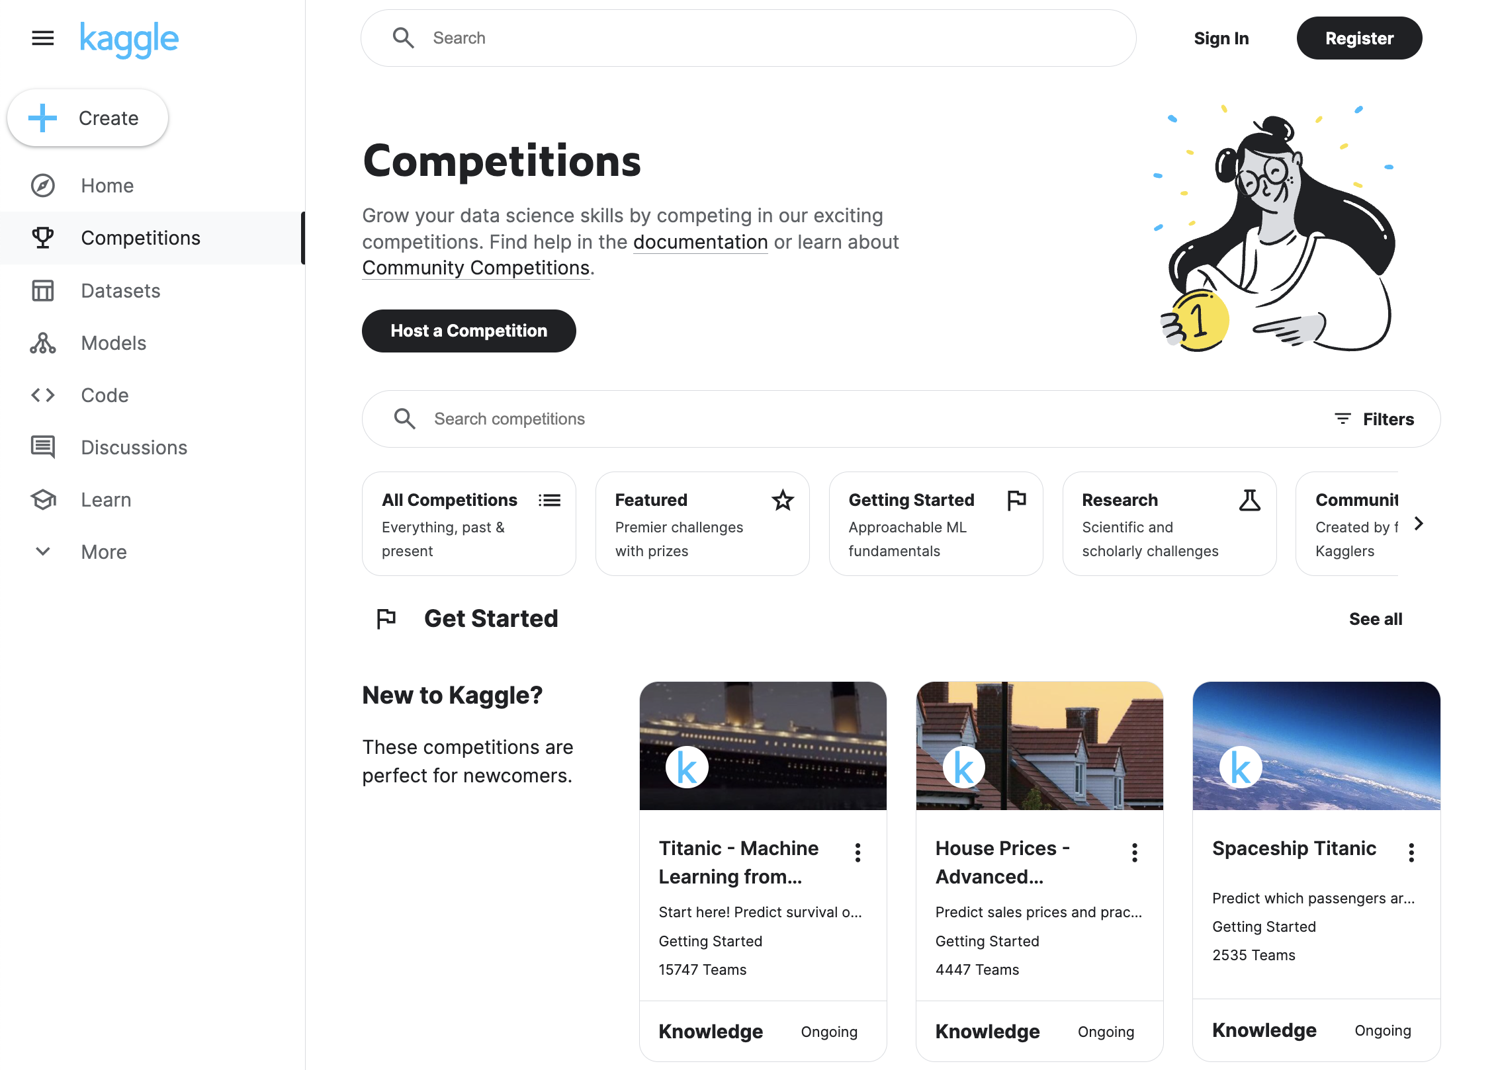
What is Kaggle?
3. Kaggle Project
Kaggle is the world's largest data science community and platform for data science competitions, machine learning challenges, and collaborative data science projects
Owned by Google
Wide range of competitions with varying levels of complexity
Also offers datasets, code notebooks, and other resources
https://www.kaggle.com/competitions

Slide 12
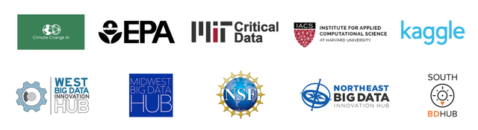
Kaggle Project Introduction
3. Kaggle Project
WiDS Datathon 2022
Organized by the WiDS Worldwide Team, Stanford University, Harvard University IACS, among others.
Partnered with Climate Change AI, Lawrence Berkeley National Lab, US Environmental Protection Agency (EPA), and MIT Critical Data

Slide 13
Kaggle Project Introduction
3. Kaggle Project
Climate change is a globally relevant, urgent, and multi-faceted issue heavily impacting many industries and aspects of public life
Choose to explore 1 dataset among several, spanning sectors including healthcare, energy and environmental protection

Slide 14
Kaggle Project Introduction
3. Kaggle Project
Choose 1 of 3 research tracks to explore:
US Environmental Protection Agency (EPA): weather, air pollutant, and census data
MIT Critical Data: CDC county level COVID data
Climate Change AI: Fine grained building energy usage data
https://www.kaggle.com/competitions/phase-ii-widsdatathon2022

Slide 15
1. Introduction
Who am I?
Who are you?
2. Our Goal
Project Goal
Project Timeline
3. Kaggle Project
What is Kaggle?
Kaggle Project Introduction
Setting up Project and Team
4. Data Understanding
Data Understanding and Problem Formation

Slide 16
Data Understanding and Problem Formation
4. Data Understanding
Independent Variables:
'AQS_ID’
'LATITUDE’
'LONGITUDE’
'COUNTY’
'STATE’
'CBSA’
'PEOPLE_OF_COLOR_FRACTION’
'LOW_INCOME_FRACTION’
'LINGUISTICALLY_ISOLATED_FRACTION’
'LESS_THAN_HS_ED_FRACTION’
'DATE', 'TEMPERATURE_CELSIUS’
'RELATIVE_HUMIDITY’
'WIND_SPEED_METERS_PER_SECOND’
'WIND_DIRECTION'
'OZONE_PPM’
'NO2_PPB’
'CO_PPM’
'SO2_PPB’
'LEAD_UG_PER_CUBIC_METER’
'BENZENE_PPBC’
Fall 2023 Dataset
Target Variable:
'PM25_UG_PER_CUBIC_METER’

Slide 17
Data Understanding and Problem Formation
4. Data Understanding
Independent Variables:
'AQS_ID’
'LATITUDE’
'LONGITUDE’
'COUNTY’
'STATE’
'CBSA’
'PEOPLE_OF_COLOR_FRACTION’
'LOW_INCOME_FRACTION’
'LINGUISTICALLY_ISOLATED_FRACTION’
'LESS_THAN_HS_ED_FRACTION’
'DATE', 'TEMPERATURE_CELSIUS’
'RELATIVE_HUMIDITY’
'WIND_SPEED_METERS_PER_SECOND’
'WIND_DIRECTION'
'OZONE_PPM’
'NO2_PPB’
'CO_PPM’
'SO2_PPB’
'LEAD_UG_PER_CUBIC_METER’
'BENZENE_PPBC’
Weather Data
Location Data
Fall 2023 Dataset
Atmospheric
Data
Demographic
Data
Target Variable:
'PM25_UG_PER_CUBIC_METER’
Problem Formation
What is the PM2.5 level for the next 7 days in Los Angeles?

Slide 18
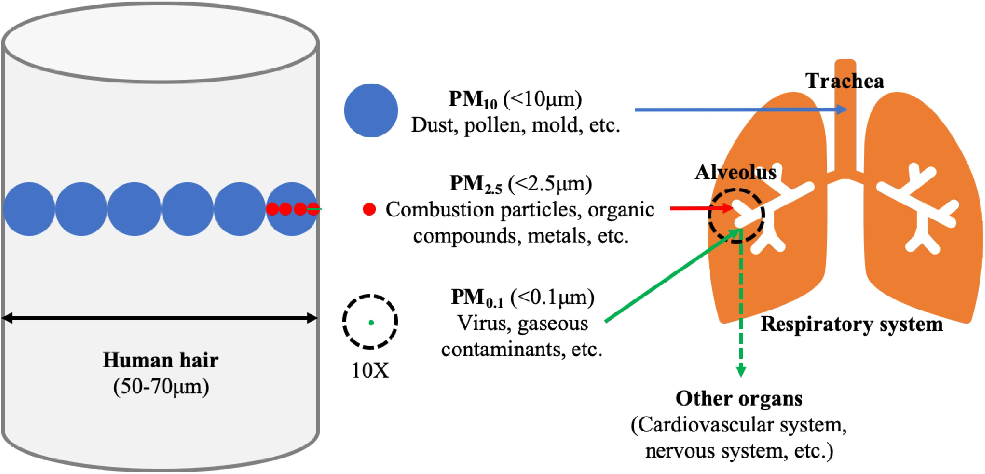
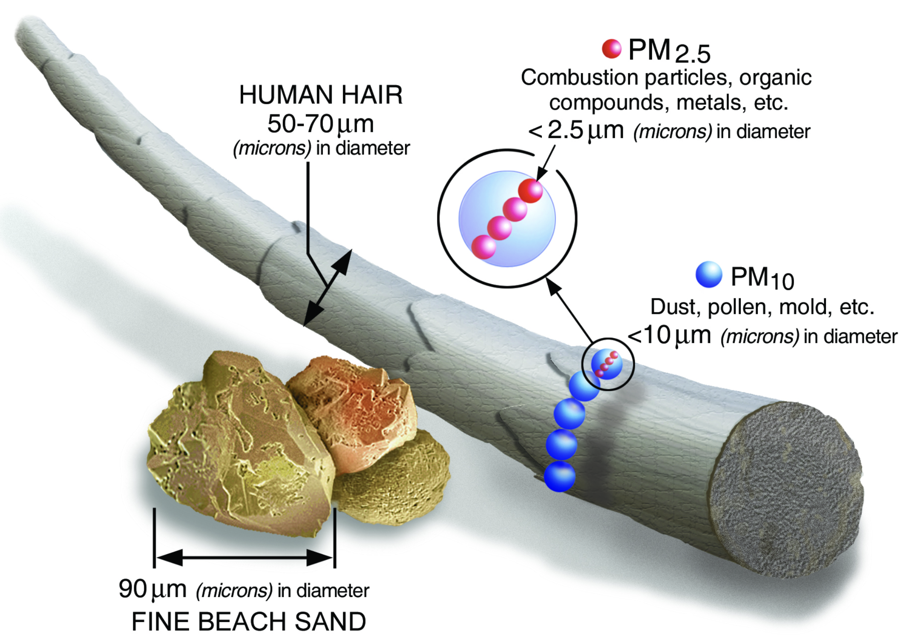
Data Understanding and Problem Formation
4. Data Understanding
What is PM2.5?
Atmospheric particles with a diameter ≤ 2.5 micrometers
The Global Burden of Disease (GBD) Study 2015 ranked PM2.5 as the 5th leading risk factor for death.
Caused 4.2 million deaths and 103.1 million disability-adjusted life-years loss, representing 7.6% of total global deaths.

Slide 19
What data do we have now?
Independent Variables:
'AQS_ID’
'LATITUDE’
'LONGITUDE’
'COUNTY’
'STATE’
'CBSA’
'PEOPLE_OF_COLOR_FRACTION’
'LOW_INCOME_FRACTION’
'LINGUISTICALLY_ISOLATED_FRACTION’
'LESS_THAN_HS_ED_FRACTION’
'DATE’, 'TEMPERATURE_CELSIUS’
'RELATIVE_HUMIDITY’
'WIND_SPEED_METERS_PER_SECOND’
'WIND_DIRECTION'
'OZONE_PPM’
'NO2_PPB’
'CO_PPM’
'SO2_PPB’
'LEAD_UG_PER_CUBIC_METER’
'BENZENE_PPBC’
Weather Data
Location Data
Spring 2024 Dataset
Atmospheric
Data
Demographic
Data
Target Variable:
'PM25_UG_PER_CUBIC_METER’

Slide 20
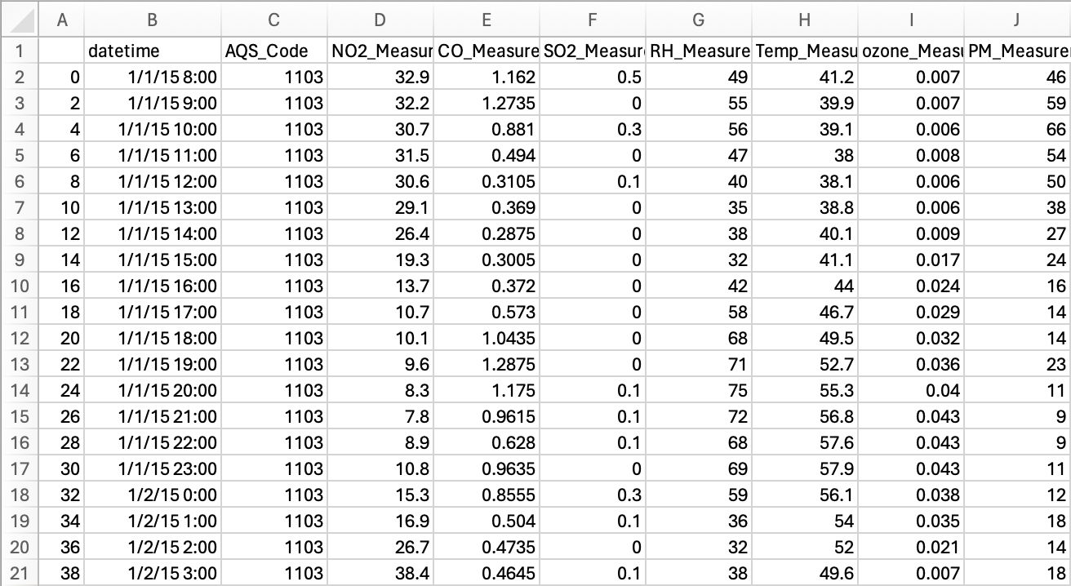
4. Data Understanding
Spring 2024 Dataset

Slide 21
Ending
What visualizations should we do?
Any new insights?

